Slide 1


Parceive
Software Architecture Analysis for Parallelization
Nathaniel Knapp
August 10, 2016

Slide 2
Introduction Overview DEMO PARASITE PARASITE ALGORITHM

Slide 3
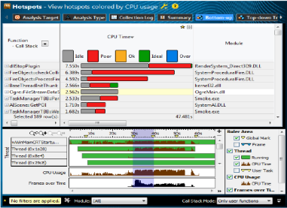
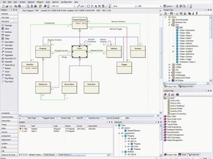
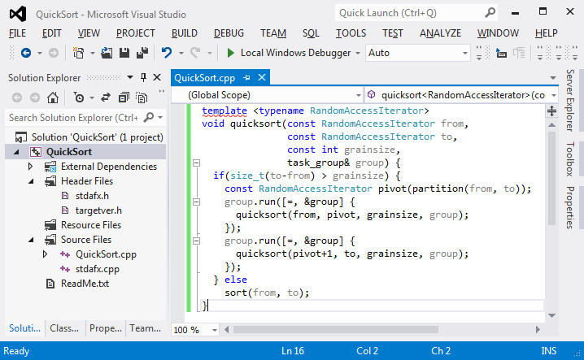
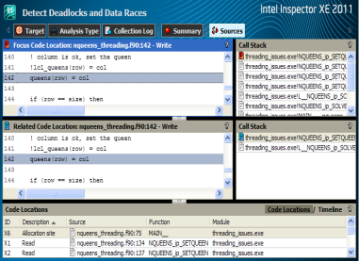
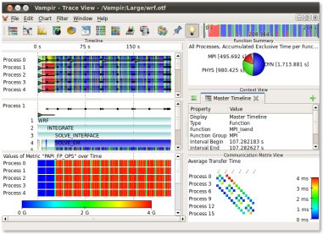
Parallelization requires 5 Steps
Concurrency
identification
Architecture
redefinition
Validation and
Verification
Runtime analysis
Parallelization
Notes:
Quickly go over the steps. Tell audience roughly what they do. That’s the usual approach in industry. Don’t go into details about tooling (bullet points) for each step. For each of the five points, think of one to two sentences to describe the whole slide so that it makes sense for the audience. Transition: Concurrency identification is the most complicated step – because this means software comprehension.

Slide 4

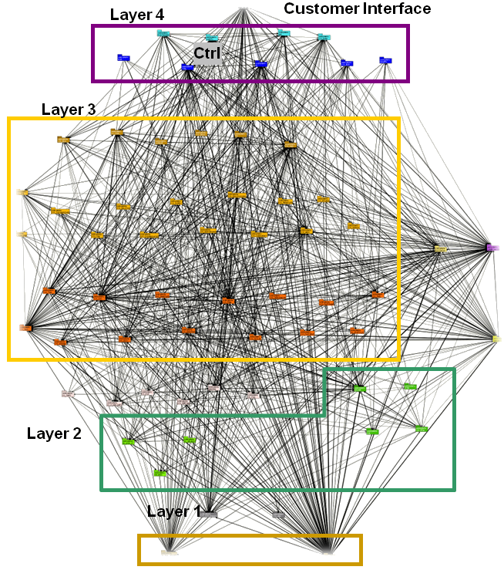
Concurrency Identification
Main challenges
Detecting hotspots
Communication
Locality preservation
Synchronization
Load balancing
Questions
Where to start?
How to find shared data?
Is it a good idea to parallelize?
…
Parallelization requires a deep understanding of the software architecture (especially regarding shared data access).
Notes:
Emphasize: this is a tool for sequential software to multicore processors – SHARED MEMORY. Tell audience what the typical challenges are when you do identificaiotn of available concurrency: 1, 2, 4, and 5. One sentence for every point. 1. where are bottlenecks. 2. Communication: how do component send info to each other. 3. Often it is important to keep computations that are related together (low coupling, high cohesion). 4. Locks 5. Utilization of processors
Last question: the most important question – some problems are strictly sequential. Parallelizaiton makes program more complex, and you need experienced developers.

Slide 5
Introduction Overview DEMO PARASITE PARASITE ALGORITHM

Slide 6








Parceive Overview
C/C++
C#/.NET
Parallelization requires a deep knowledge of the application’s software architecture and often entails extensive refactoring.
Data Collection
Platform-independent tool that supports software architects and developers in parallelizing large software projects.
Analysis
Visualization
Notes:
Overall overview of how Parceive works – what it does. Binary instrumentation – key. Take executables from C/C++/C# programs and instrument them during runtime, with callbacks to analysis code. By the analysis code, we create a trace, store that in a database. Analysis is the refinement step – get higher level information. Vis reads refined trace to give user separate viewpoints on software.

Slide 7
Introduction Overview DEMO PARASITe PARASITE ALGORITHM
Notes:
Describe what the demo is showing first. Also, why the demo is fast – data is loaded on demand – the entire trace is not loaded all at once. During demo, describe what is going on as new things pop up.

Slide 8


Slide 9
Introduction Overview DEMO PARASITE PARASITE ALGORITHM

Slide 10
Parasite
Extension of Parceive
Adds scalability estimates for application and individual call sites
Parallelism estimates include effect of synchronization
Interfaces with interactive visualization
Notes:
Add overview Figure from yesterday to this slide. All slides should have a picture!

Slide 11
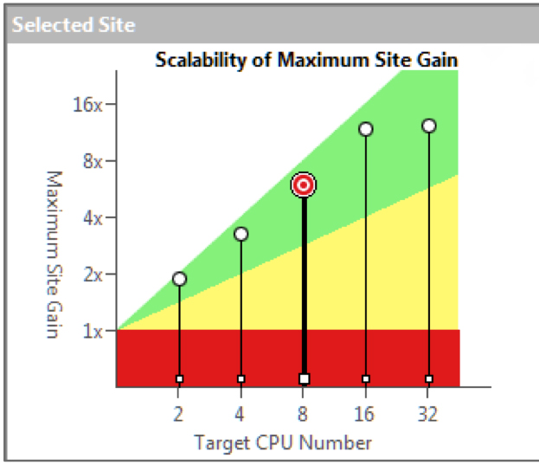
Motivation
Show when and where to parallelize
Reduce risk for management
Reduce time for programmers
Efficiently apply computing resources
Parallel application comprehension

Slide 12
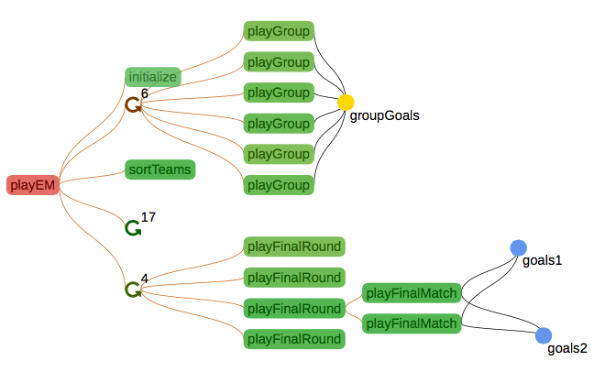
User Interface
Option A - Profile existing parallel code
Option B - Annotate sequential code
Allows easy determination of parallelization feasibility and payoff

Slide 14
Parallelism (local speedup bound)
Elapsed time

Slide 15
Introduction Overview DEMO PARASITE PARASITE ALGORITHM

Slide 16
Work
Create
Join
Join

Slide 17
Span (critical path)
Create
Join
Join
Parallelism = work / span

Slide 18
Measures work and span to get parallelism
Updates work, prefix, continuation, and longest child running totals for each call site when Events occur
Parasite Algorithm
Create
Join
Join
Notes:
This slide – show the create and join events.

Slide 19
For top thread:
Longest path
Continuation
Longest child
Before Join Event 1
Notes:
This slide – show the create and join events.

Slide 20
For top thread:
Prefix
Continuation
Longest child
Before Join Event II
Notes:
This slide – show the create and join events.

Slide 21
For top thread:
Prefix
Continuation
Longest child
After Join Event II
Notes:
This slide – show the create and join events.

Slide 22
For top thread:
Prefix
Continuation
Longest child
At top thread end

Slide 23
Summary
Parceive: Software Architecture Analysis for Parallelization
Detailed views of application structure / dependencies
Parasite: Call Site Scalability Profiling
Upper bounds for speedup from parallelization of different functions in the application

Slide 24
QUESTIONS?

Slide 25


Parceive Instrumentation
Instrumentation Time
Build control flow graph
Determine Dominators
Mark loop entries and exits
Determine stride accesses
Resolve variable names
Analysis Time
Builds shadow call stack - context sensitive - traces execution times
Detects memory accesses - Type, address, instruction
Considers Memory management
Considers Threading APIs
Notes:
Intel Pin
Pin is a framework that enables the creation of dynamic program analysis tools. The tools created using Pin, called PinTools, instrument (i.e., insert or replace code in) binary applications during run time. Thus, it requires no recompiling of source code and can support instrumenting programs that dynamically generate code.

Slide 26
Algorithm Summary
Function F calls function G: G.w = 0
Function G returns to function F: F.w += G.w
Thread T spawns thread U: U.w = 0, U.c = 0, U.p = 0, U.l = 0
Thread U returns to T: U.p += U.c, T.w += U.w
If (T.c + U.p > T.l): T.l = U.p, T.p += T.c, T.c = 0
Thread T syncs:
If (T.c > T.l), T.p += T.c; Else, T.p += T.l.
T.c = 0, T.l = 0

Slide 27
Parceive Overview
Input
Data Collection
Visualization
Analysis
Binaries
Debug information
Arguments
Source-code (optional)
Dynamic binary instrumentation
Considering - Function calls - Memory - Threads
Write trace
Filtering
Query trace-DB
Simulate events
Find dependencies
Find potential parallelism
Detect race conditions
Built upon D3.js
Function View
CCT View
Profiling/Tracing view

